Slide 1
Identifying rare cell populations and improving scRNA-seq clustering accuracy using the RECOMBINE SHC-SSL and SHC-FL algorithms
Wanru Guo1, Xubin Li2, Anil Korkut2
1Department of Biostatistics & Data Science, UTHealth
2Department of Bioinformatics and Computational Biology, MD Anderson Cancer Center

Slide 2
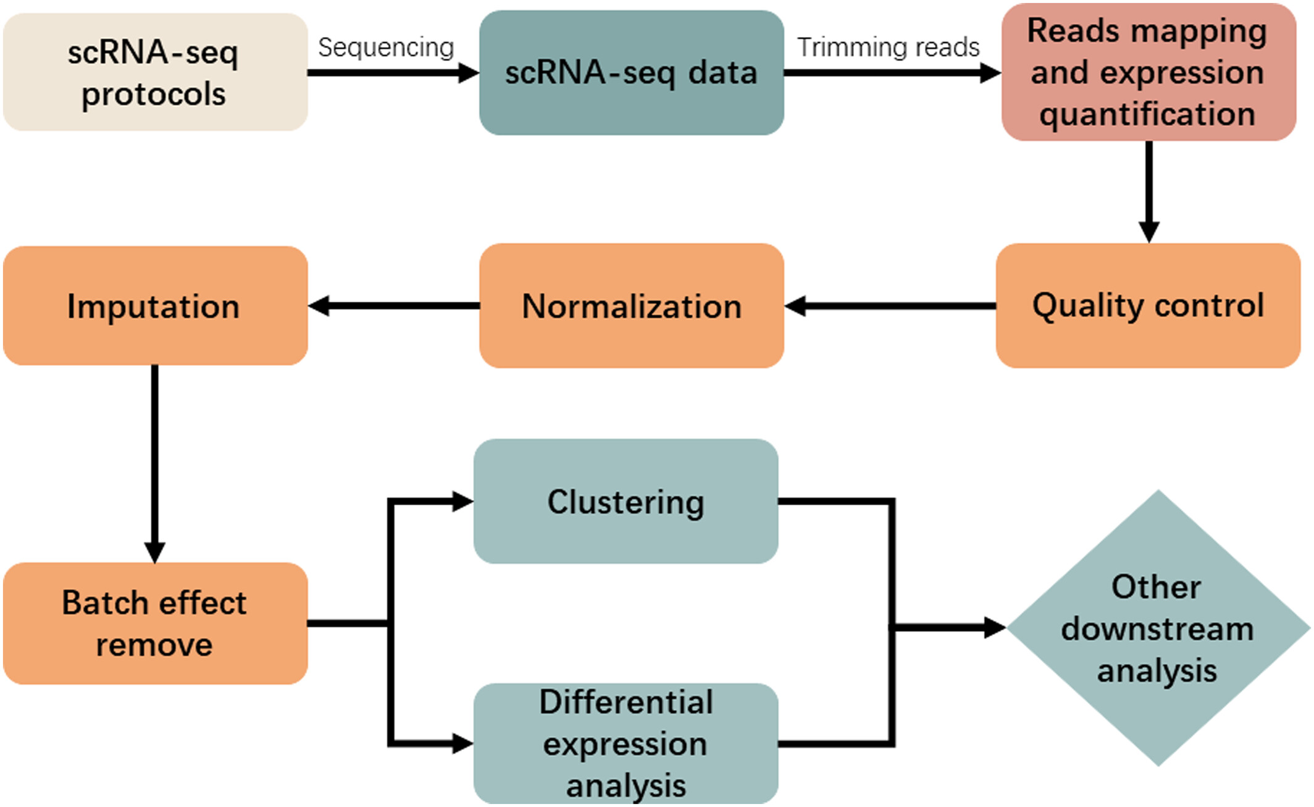
scRNA-seq analysis workflow
Feature selection
Dimensionality reduction

Slide 3
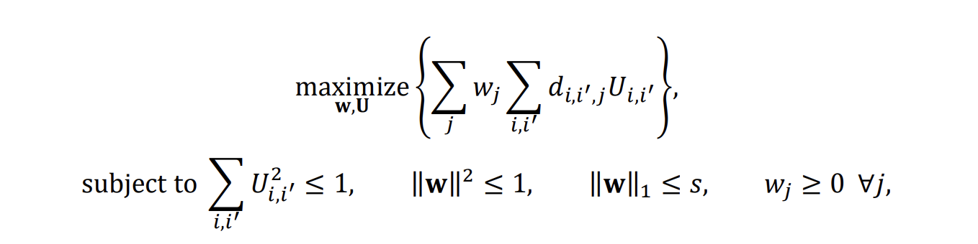
Sparse Hierarchial clustering
U: Distance Matrix (n x n)
W: Weights vector (p x 1)
This algorithm Iteratively updates U and W until convergence.
We used features with non-zero weights in W as the selected features for downstream analysis.
Is equivalent to

Slide 4
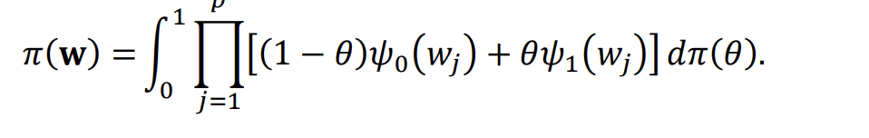
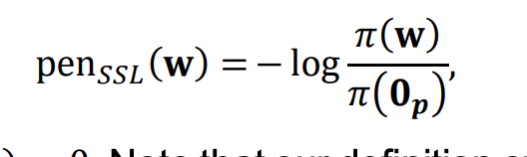
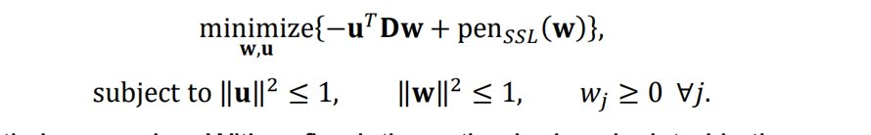
Spike-and-slab Lasso (SHC-SSL)
SHC-SSL adds a penalty to SHC
The algorithm iteratively updates U, W, and the posterior θ, ensuring convergence while maintaining the balance between sparsity and feature relevance.
Used non-zero weights in W as the selected features
Theta (θ) is prior hyperparameter that balances the contributions between the spike (sparsity-inducing) and slab (regularizing) components.
ϕ0(wj) and ϕ1(wj) depend on the parameters λ0 (spike) and λ1 (slab), respectively, and define the shape of the penalty terms for wj.
SHC-SSH vs. LASSO:
When 𝜆0 → ∞ and 𝜆1 → 0, the SSL penalty = L0-norm penalty
when 𝜆0 = 𝜆1, same as lasso penalty
continuous bridge between L0-norm and lasso penalty
3. while lasso constantly biases 𝑤̂𝑗 toward zero, SSL shrinks strongly small 𝑤̂𝑗 ’s toward zeros but only introduces very slight biases for large 𝑤̂𝑗 ’s.

Slide 5
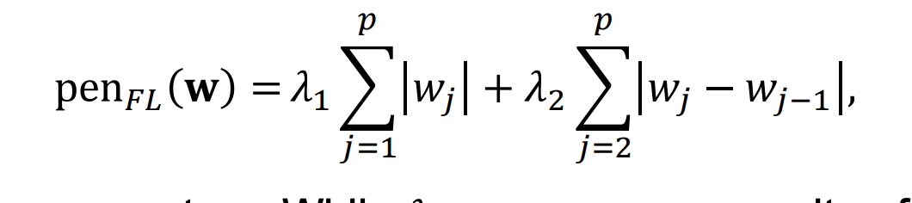
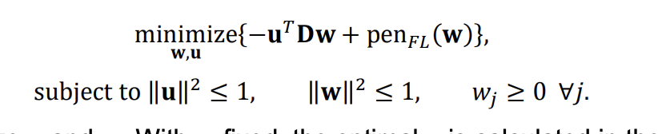
Fused Lasso
While 𝜆1 encourages sparsity of features, 𝜆2 encourages neighboring features to be similar and some to be identical

Slide 6
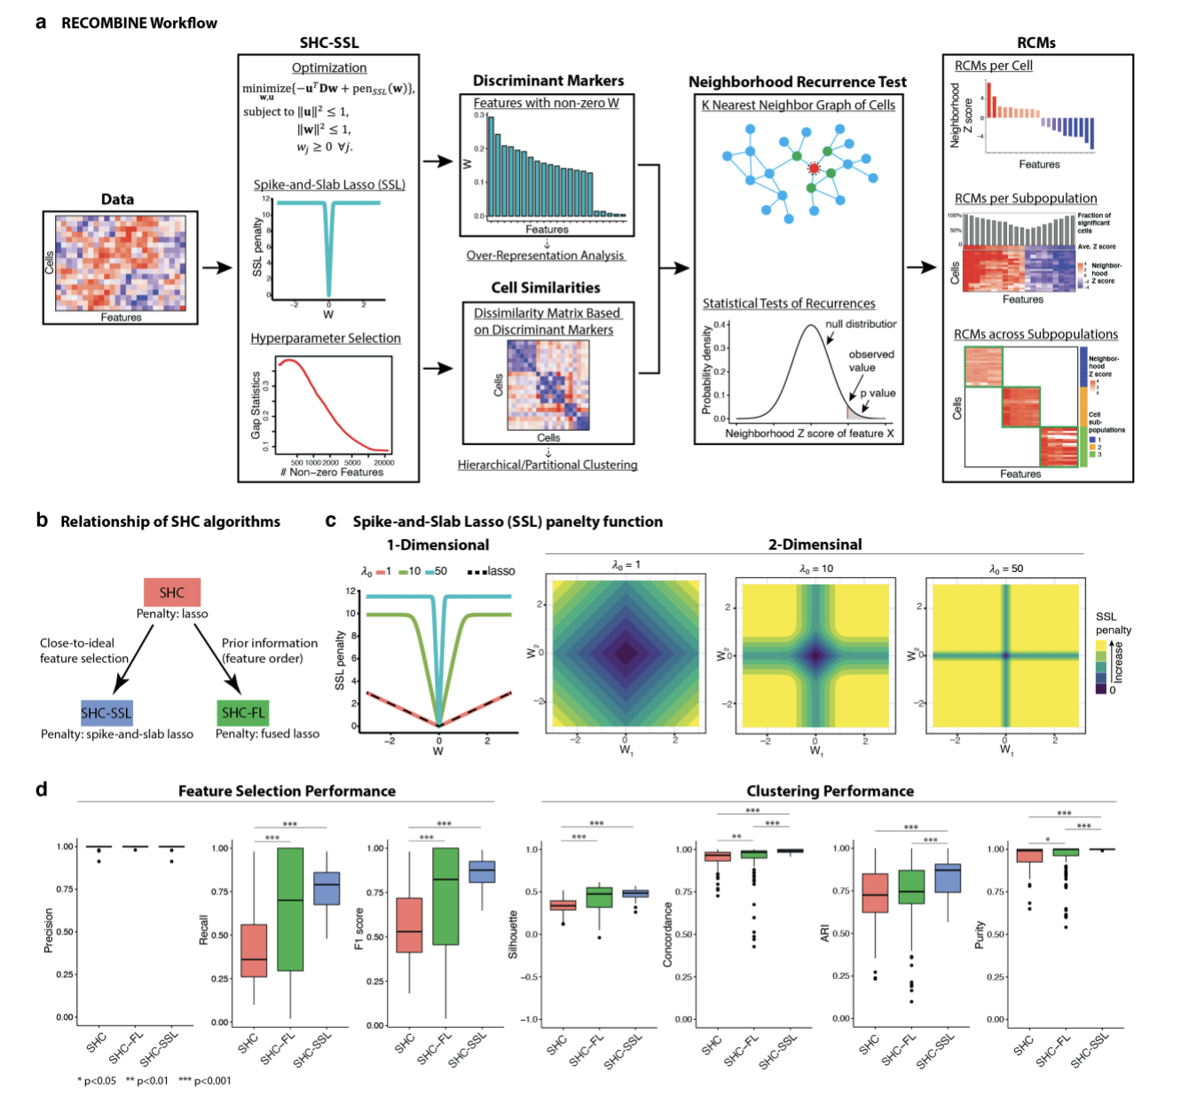
Spike and Slab Lasso and Fused Lasso
SHC-SSH vs. LASSO:
When 𝜆0 → ∞ and 𝜆1 → 0, the SSL penalty = L0-norm penalty
when 𝜆0 = 𝜆1, same as lasso penalty
continuous bridge between L0-norm and lasso penalty
3. while lasso constantly biases 𝑤̂𝑗 toward zero, SSL shrinks strongly small 𝑤̂𝑗 ’s toward zeros but only introduces very slight biases for large 𝑤̂𝑗 ’s.

Slide 7
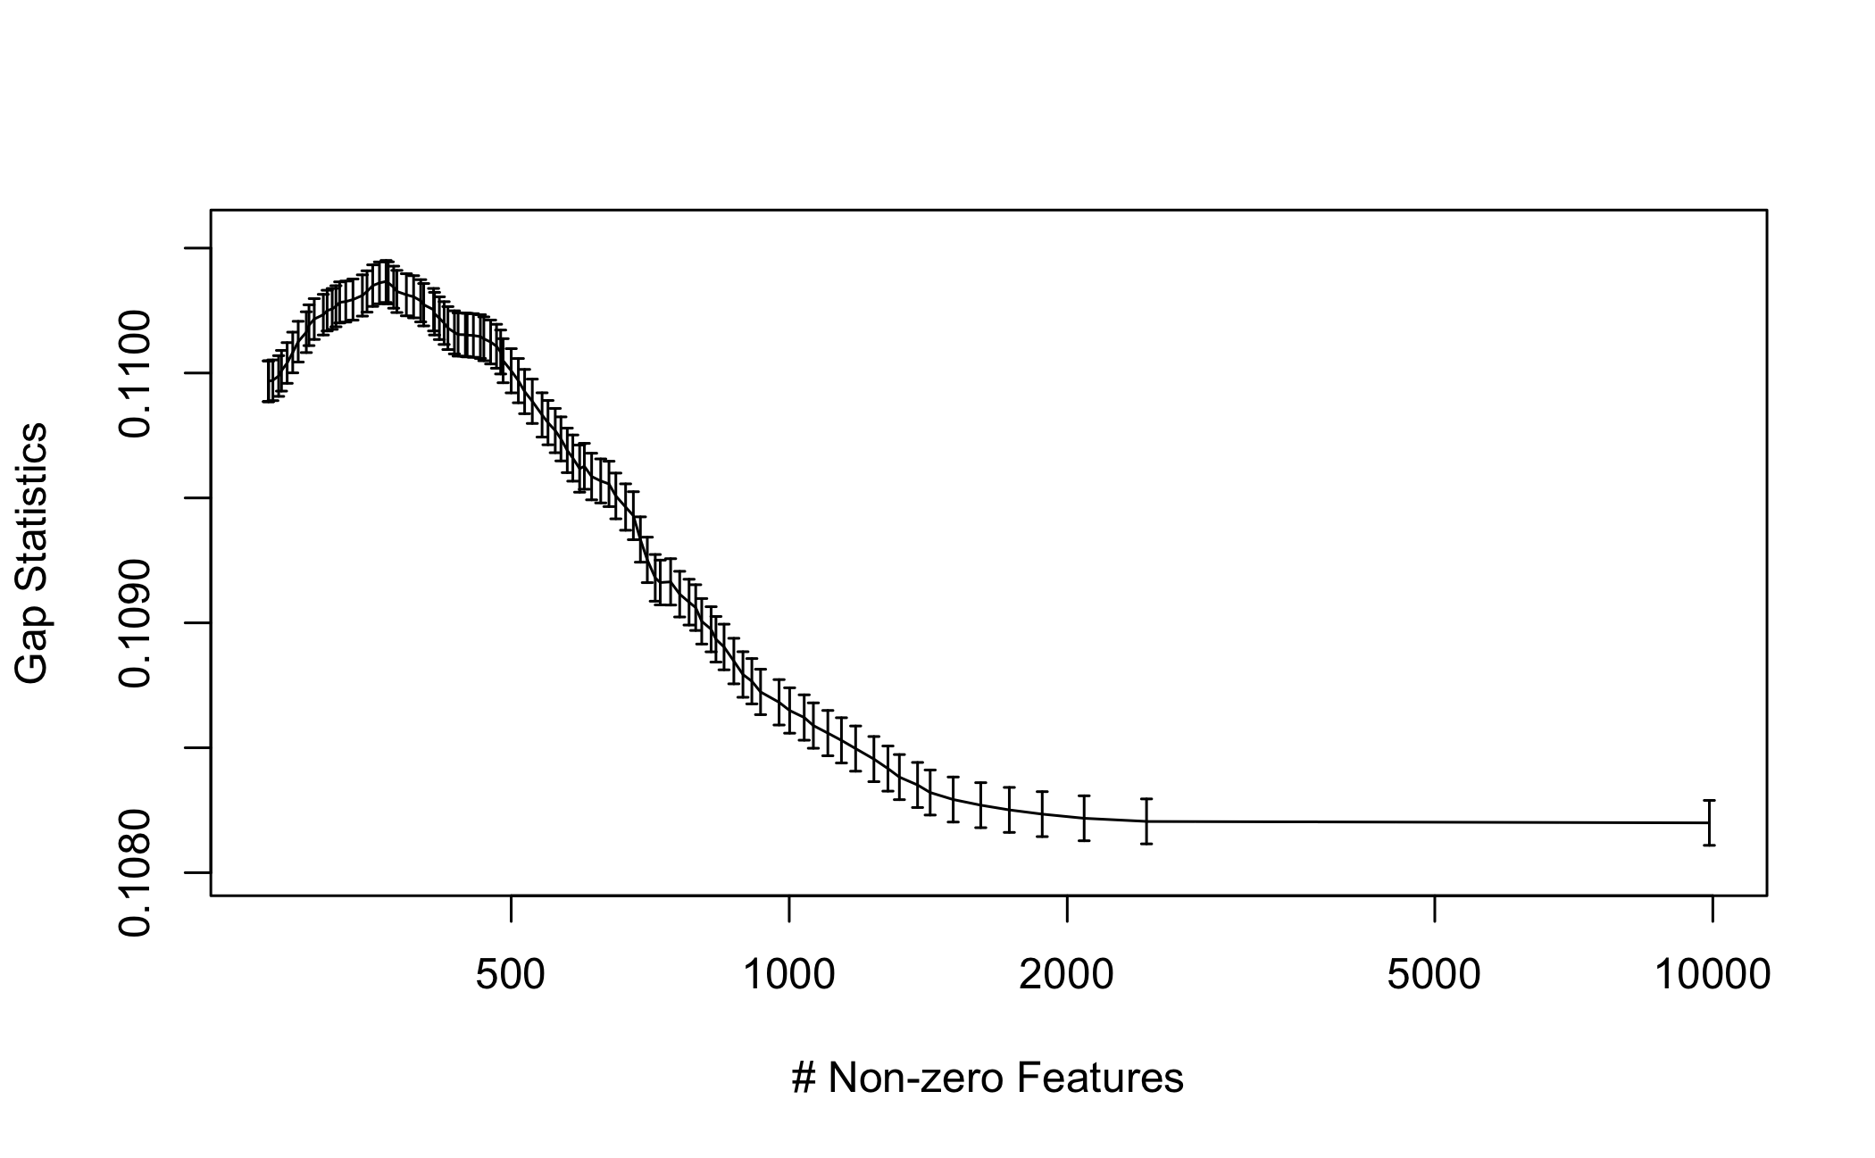
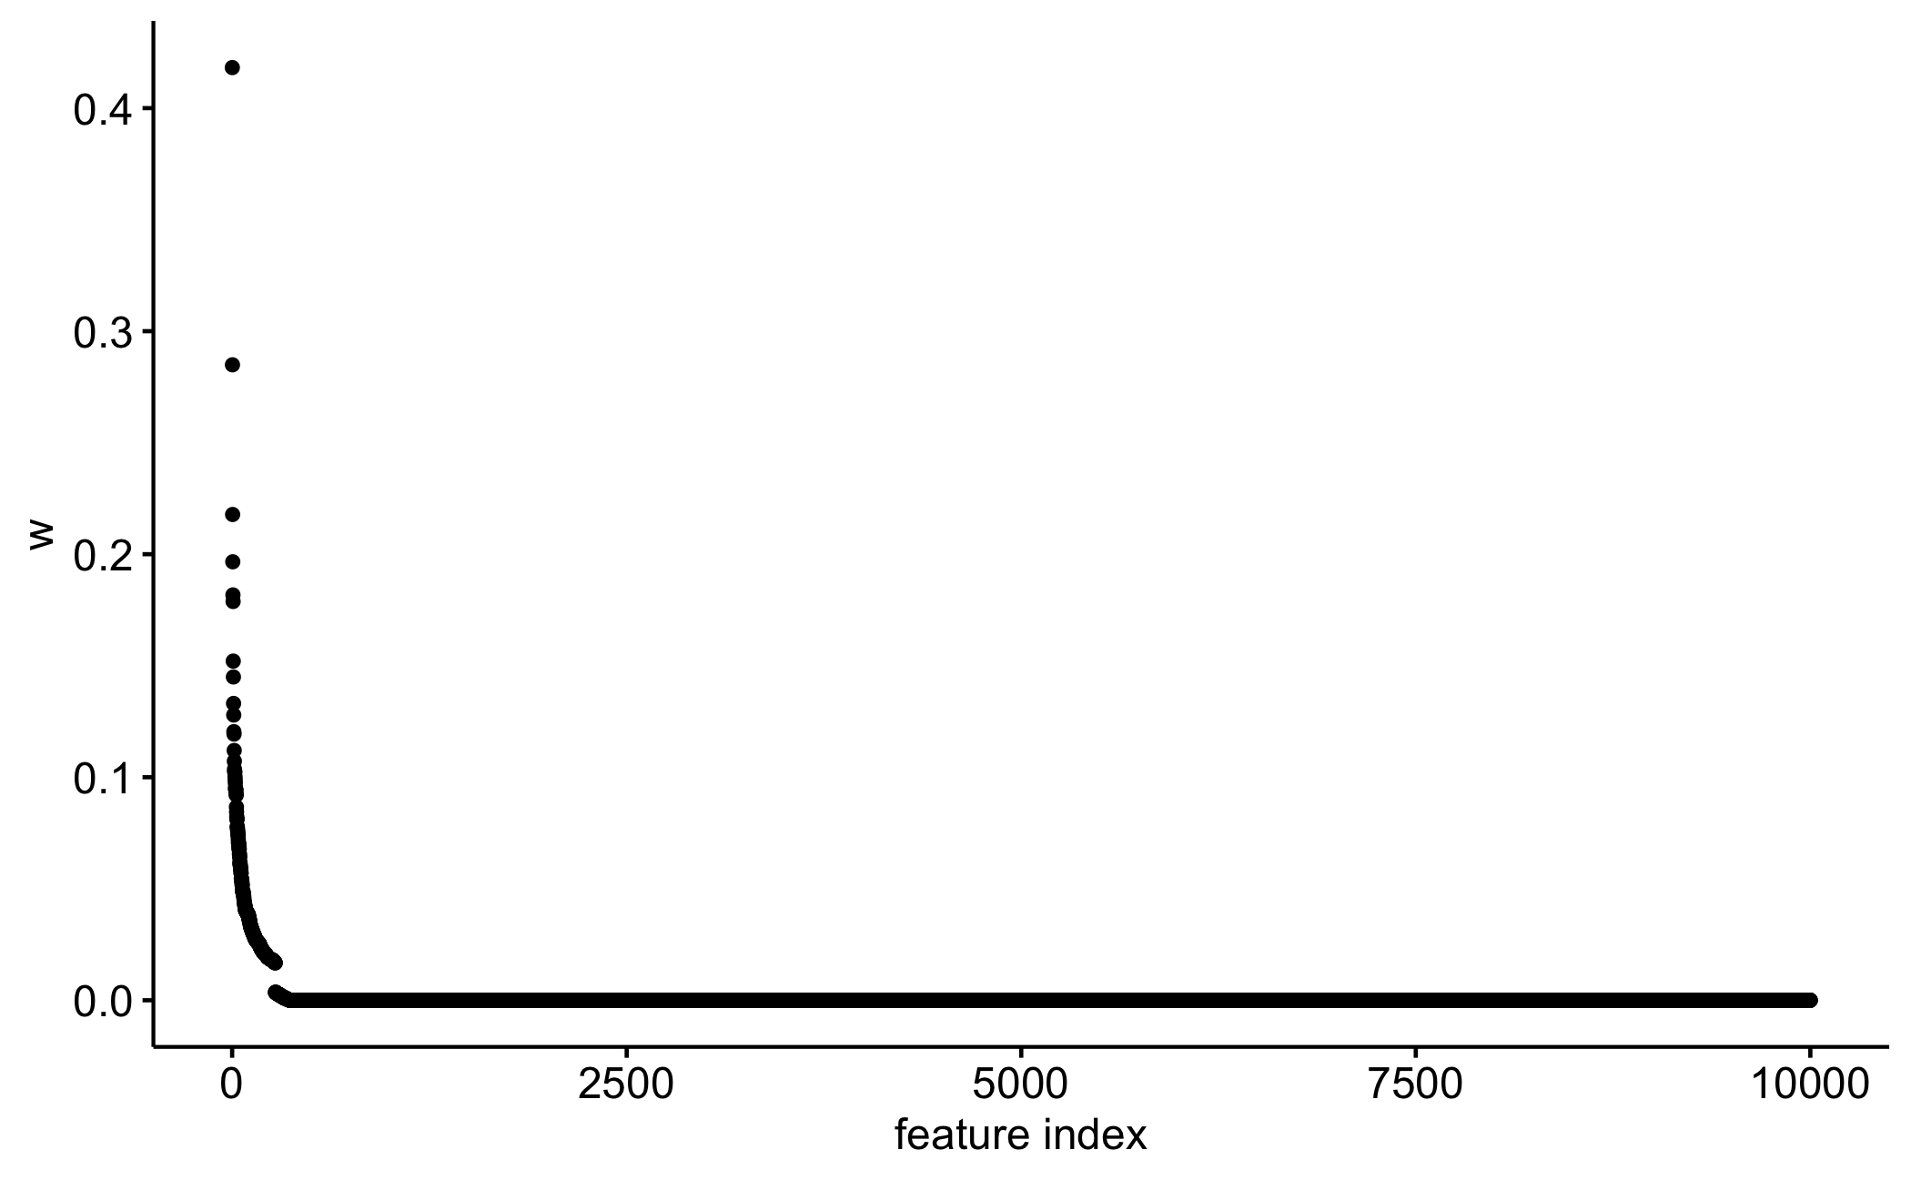
Hyperparameter selection
We fixed lamda1 and varied lambda0 (when larger, biases more smaller weights toward zero and only introduces small biases to larger weights), and selected the largest gap statistic
Features with non-zero weights were selected for downstream analysis

Slide 8
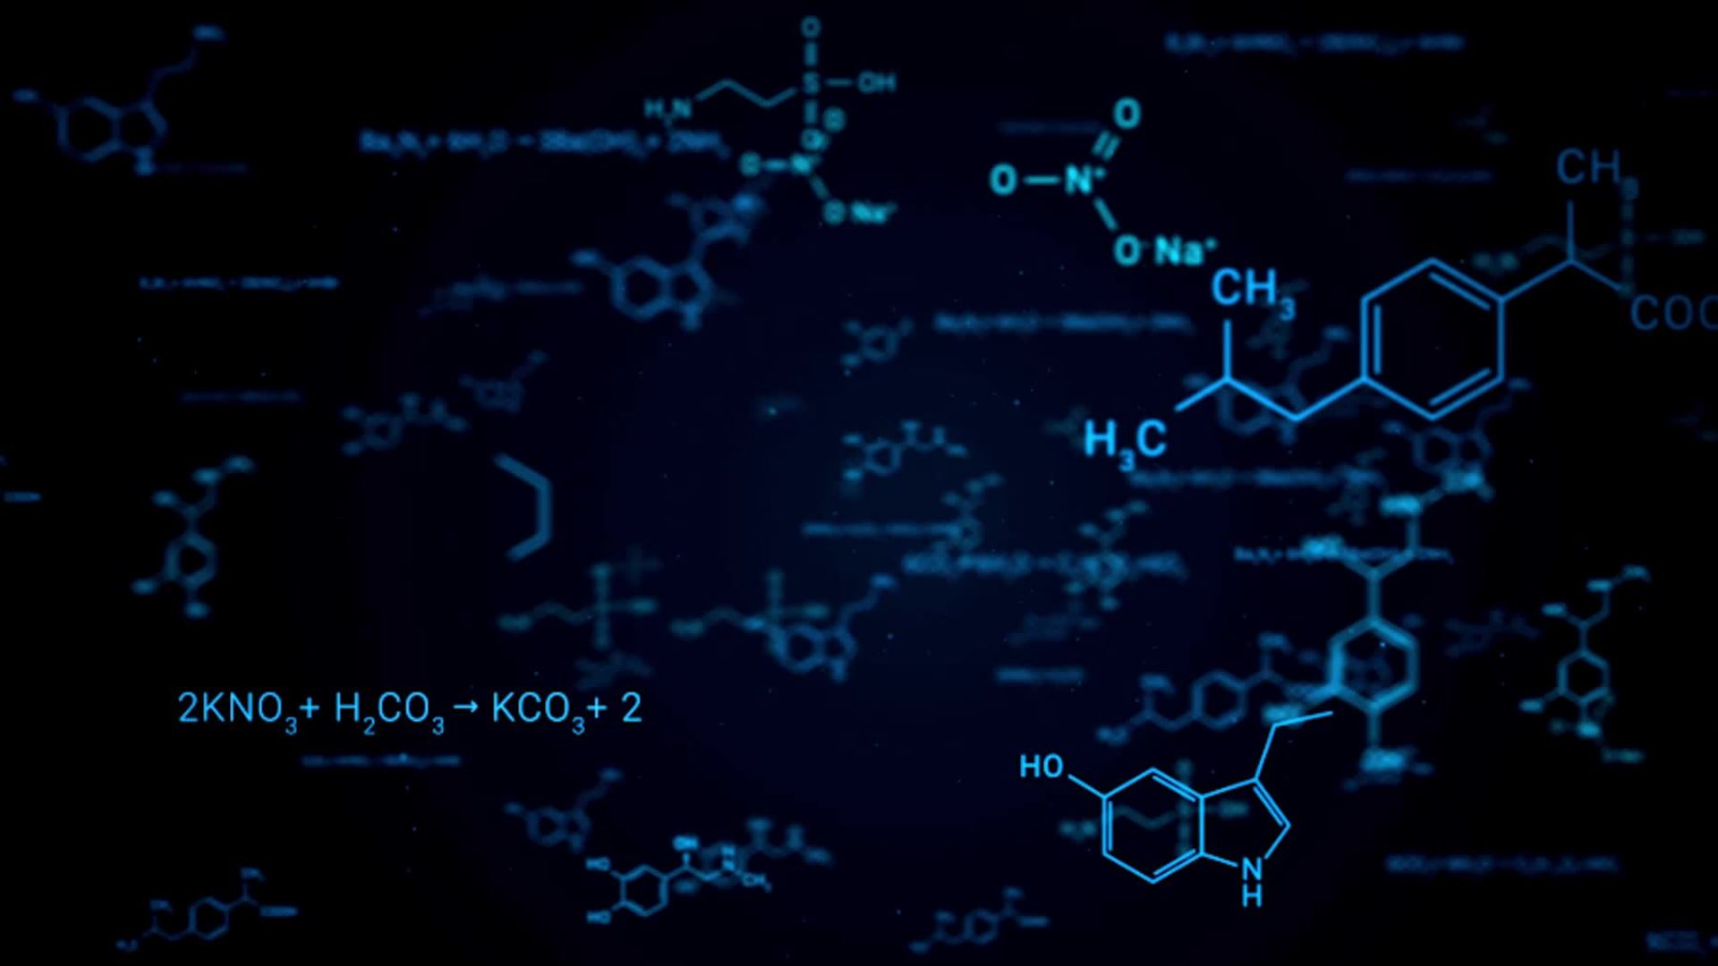
Simulation settings
simulated scRNA-seq data consisting of 200 cells x 2000 genes using a Gamma-Poisson model
5 groups (clusters), with probabilities of 0.7,0.1,0.02,0.15 and 0.03, mimicking the rare cell percentages seen in real (Tabula Sapiens) data
Clustering performance are evaluated using Adjusted Rand Index, which compares predicted clusters with ground truth

Slide 9
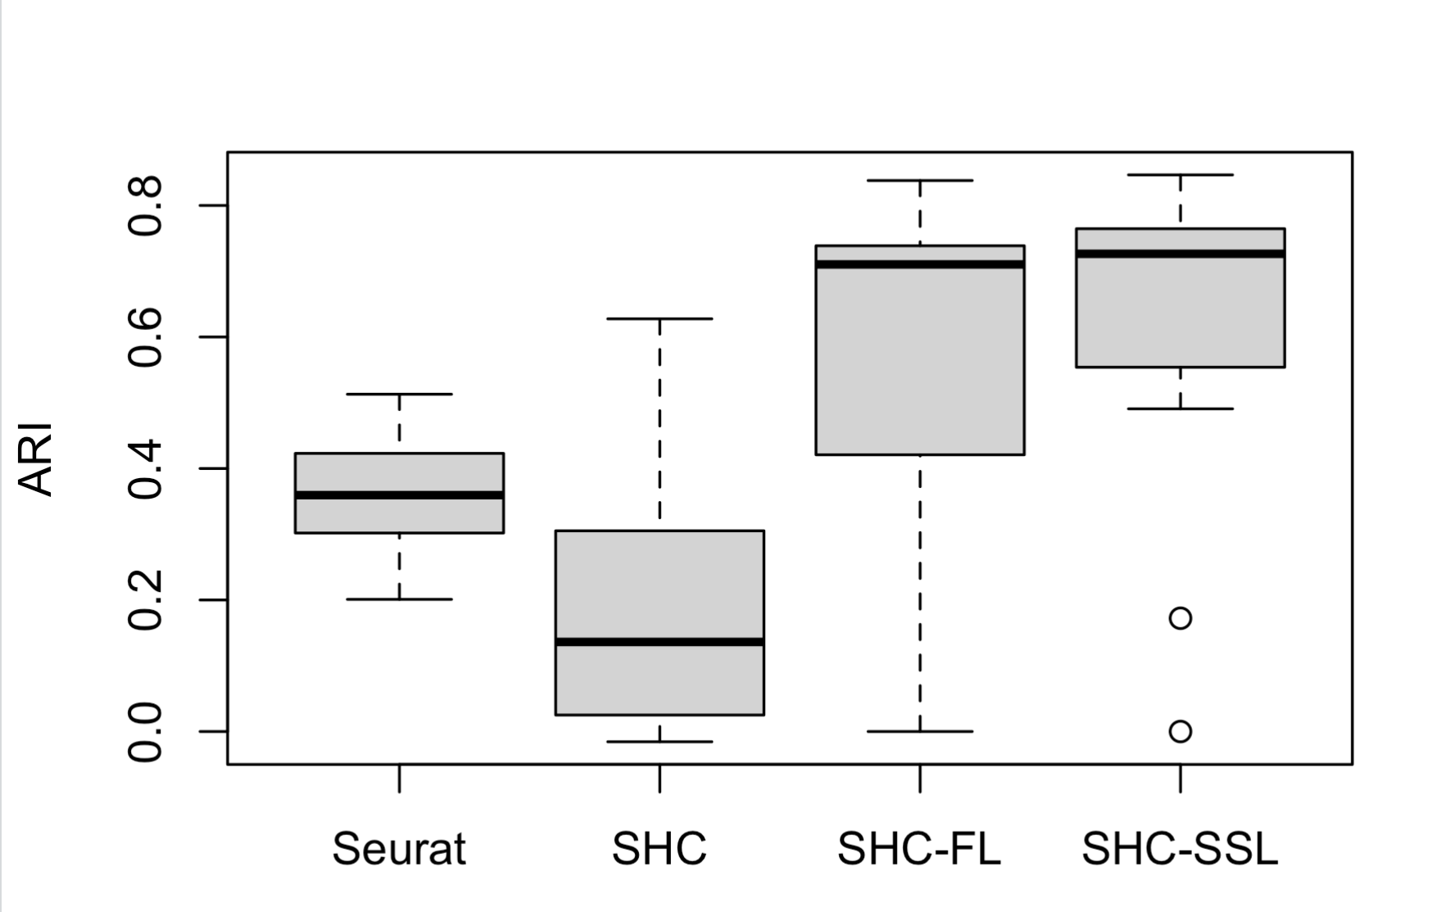
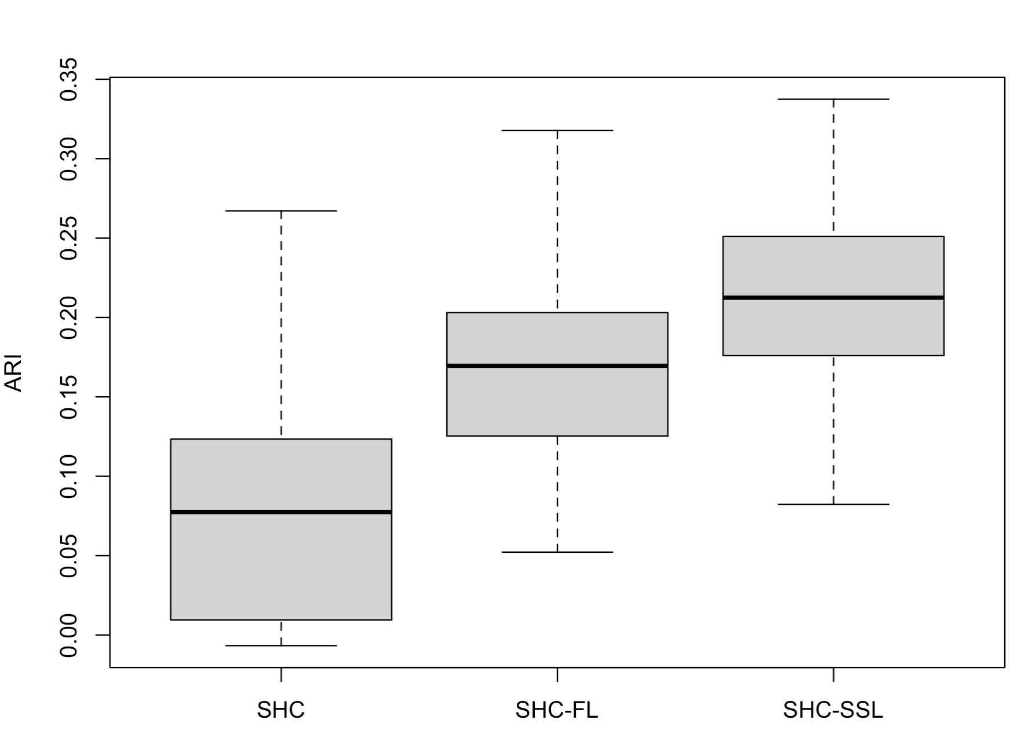
Results – Simulation SHC-SSL and SHC-FL performed better than Seurat and SHC in clustering data with rare cell populations (Louvain and SC3)
Louvain Algorithm
SC3 Clustering Algorithm

Slide 10
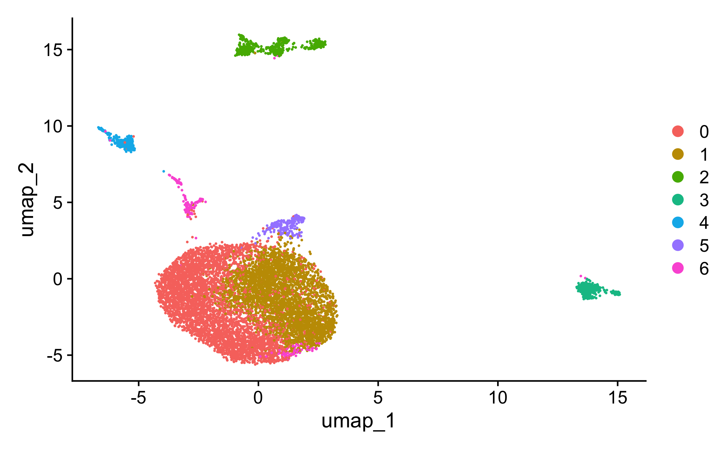
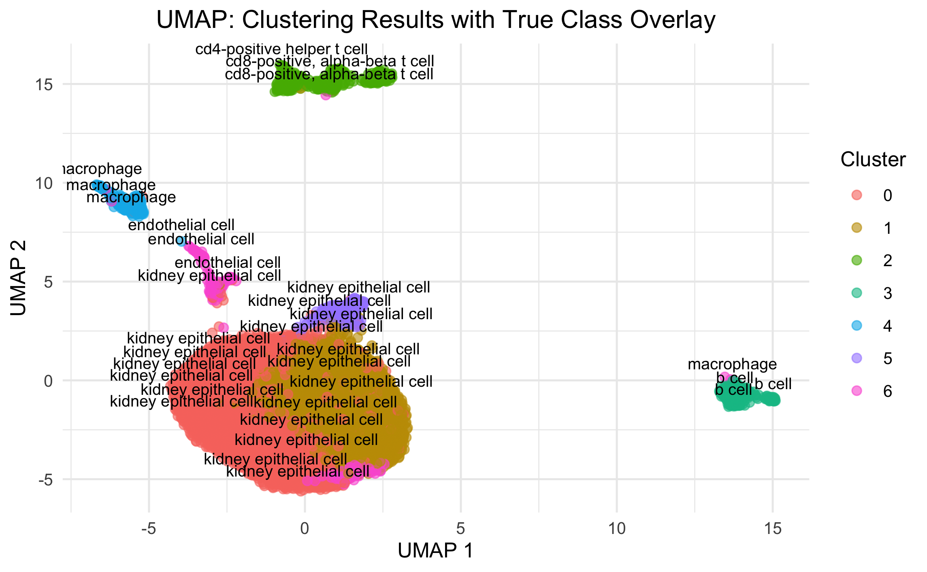
Results – TS Kidney data
Seurat
ARI: 0.300
7 cell types : Kidney epithelial cell, B cell, CD4 T cell, CD8 T cell, NK cell, Macrophages and Endothelial cell
9000 cells x 50,000 genes
-> more than 8000 out of 9000 cells are kidney epithelial cells, Seurat performs poorly in clustering the other rare cell populations (ARI: 0.300)
Seurat built in feature selection method clusters epithelial cell into 3 distinct clusters
Could not distinguish CD4 and CD8 cells, as well as macrophage and B cells

Slide 11
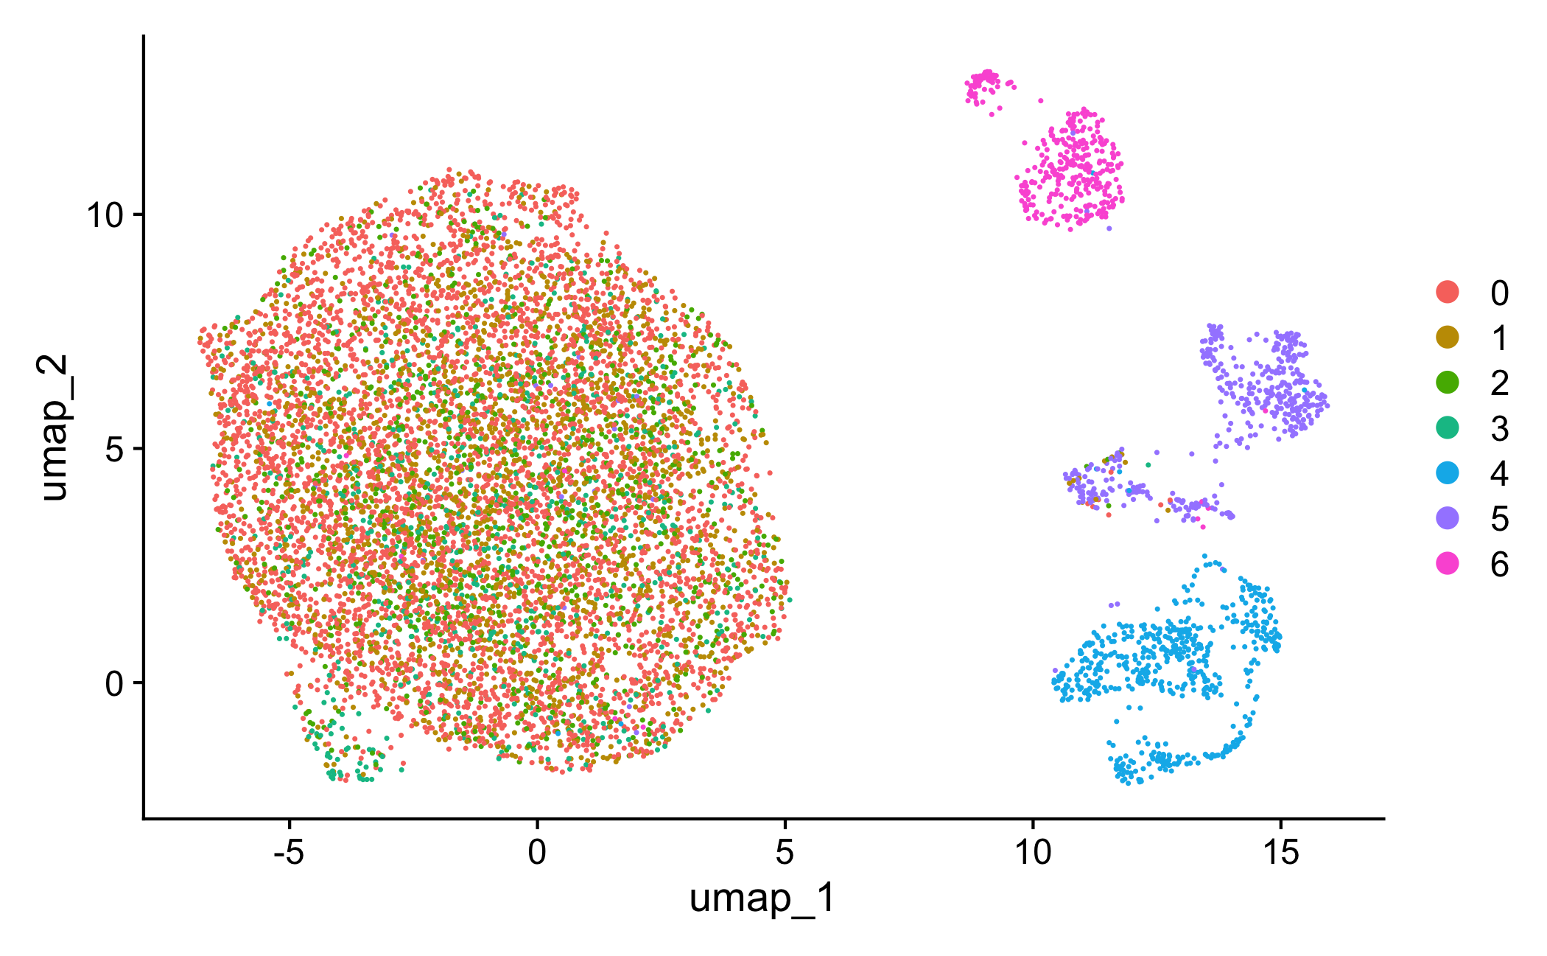
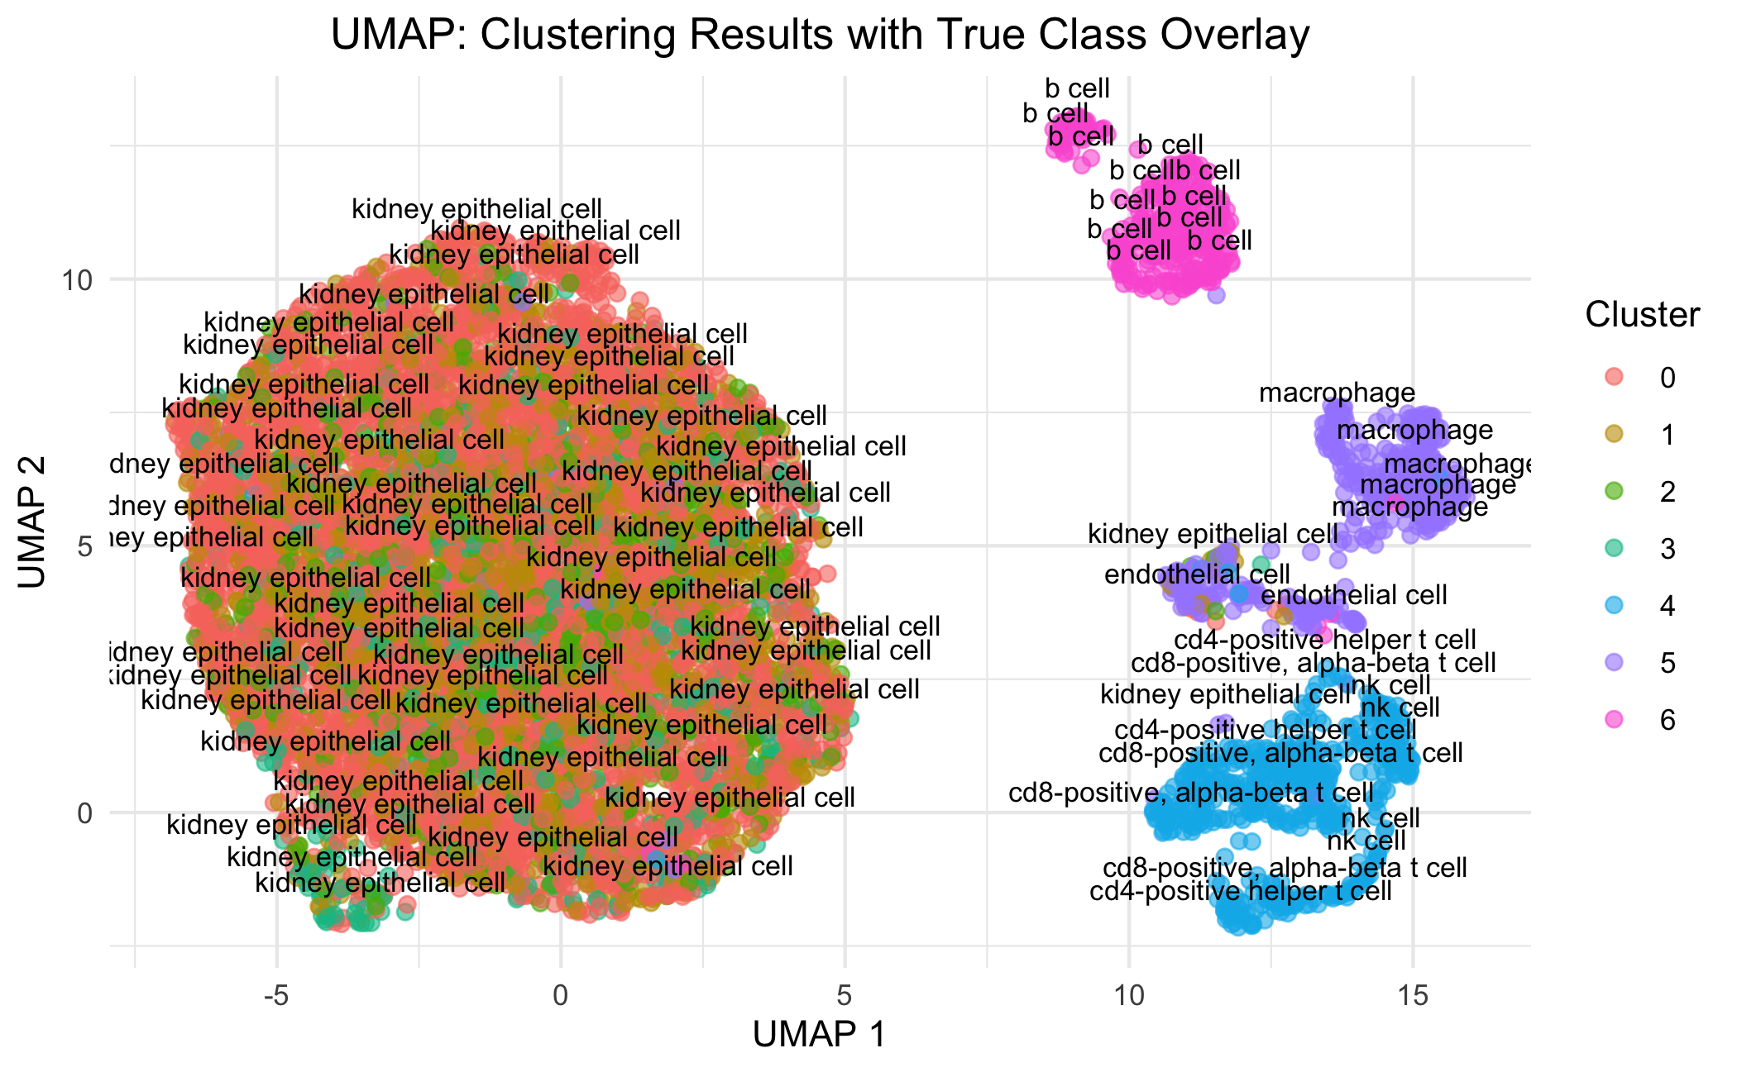
Sparse Hierarchial clustering (SHC)
SHC (without the SSL penalty) clusters kidney epithelial cells into 3 clusters
Could not distinguish CD4 and CD8 cells, as well as macrophage, endothelial cells, and kidney epithelial cells
ARI: 0.222

Slide 12
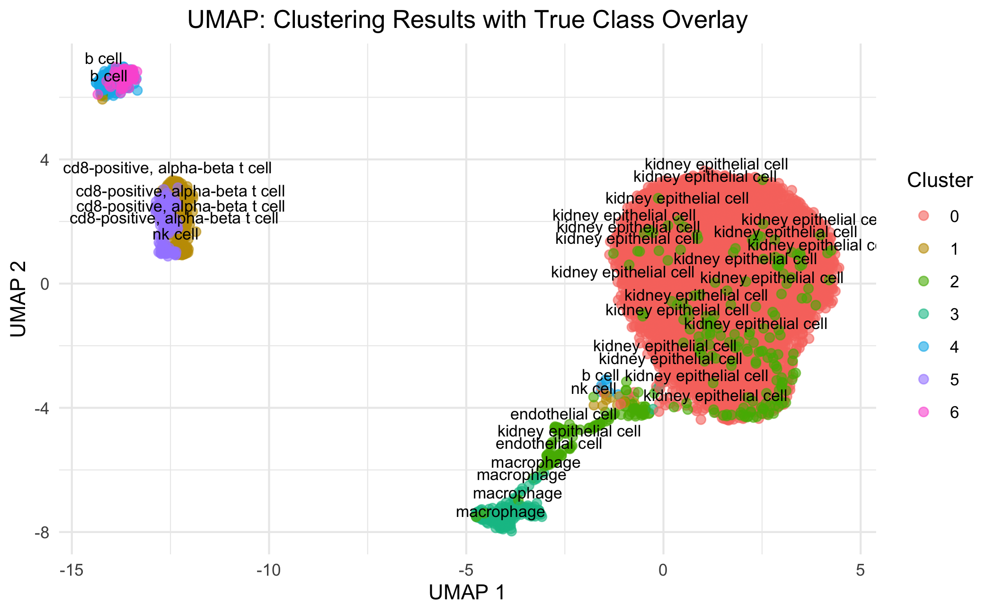
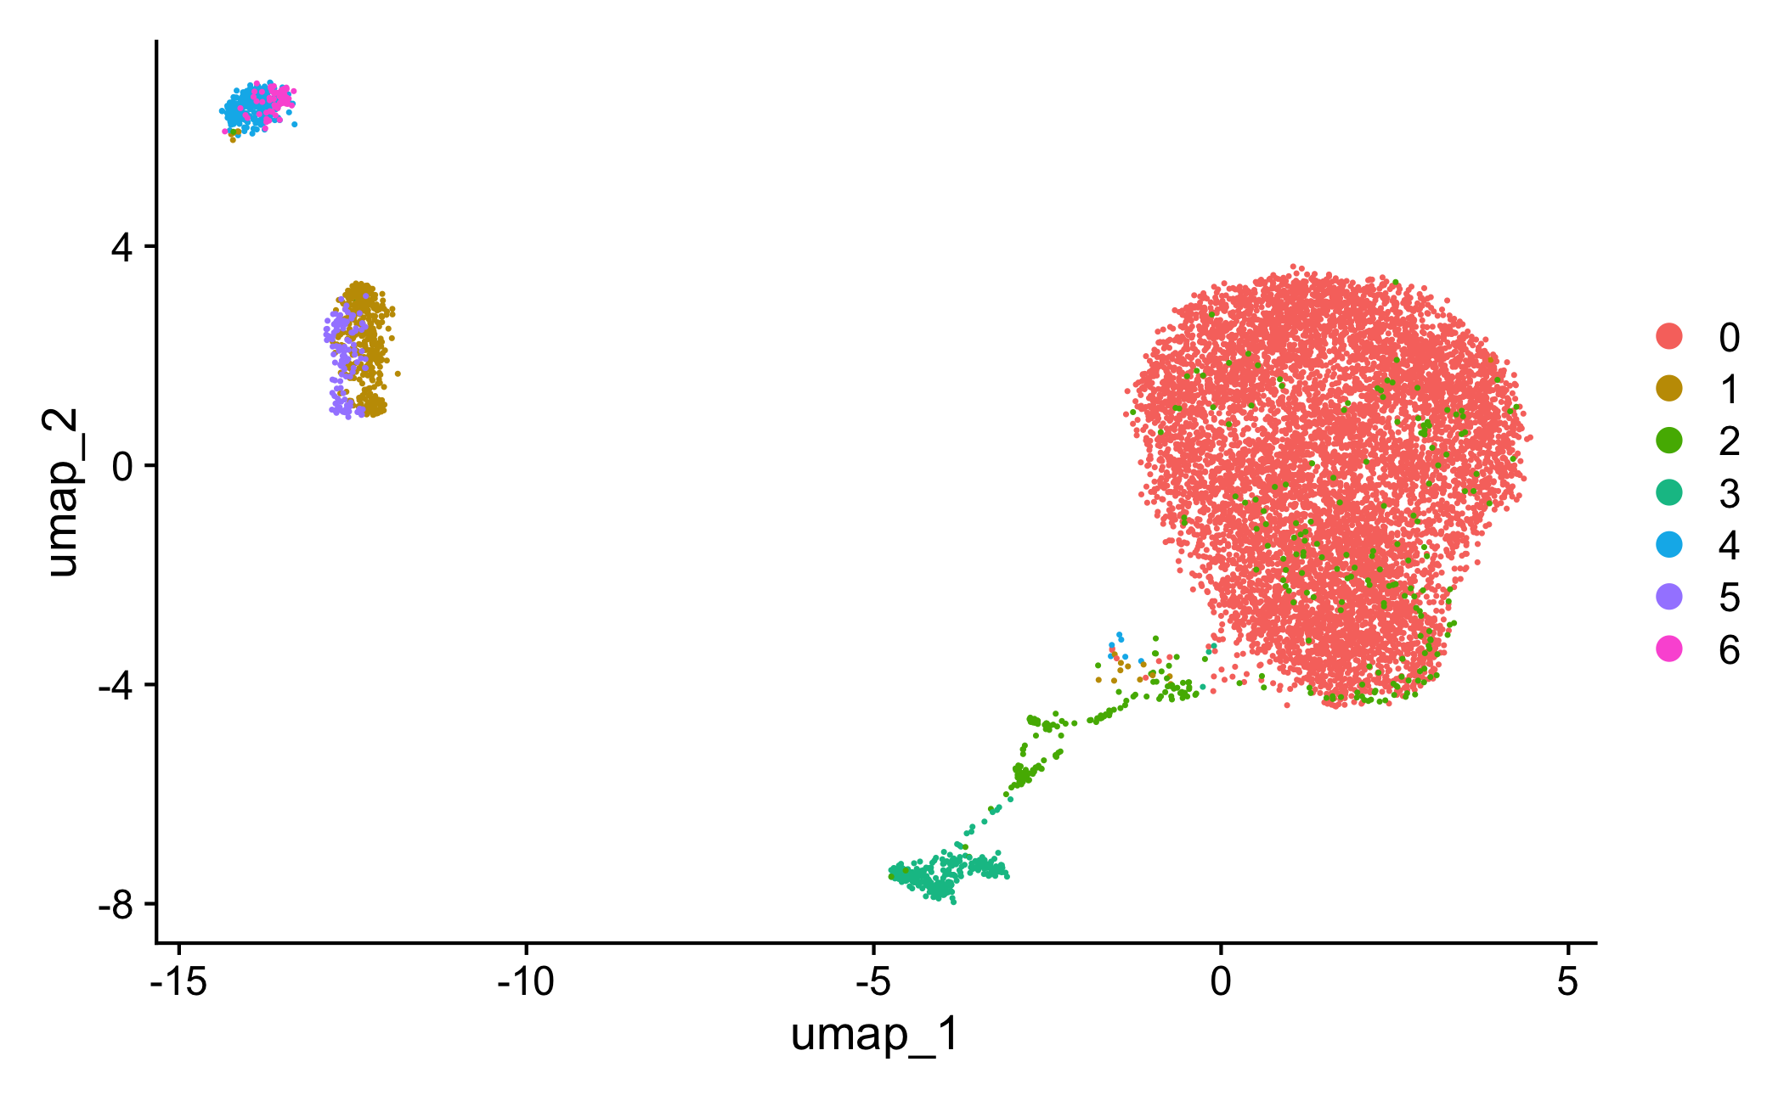
SCMarker Feature Selection
-Could clearly recognize kidney epithelial cells as a single cluster
-Could distinguish NK cells, CD8, CD4 T cells, and B cells even though they are clustered very close
ARI: 0.892

Slide 13
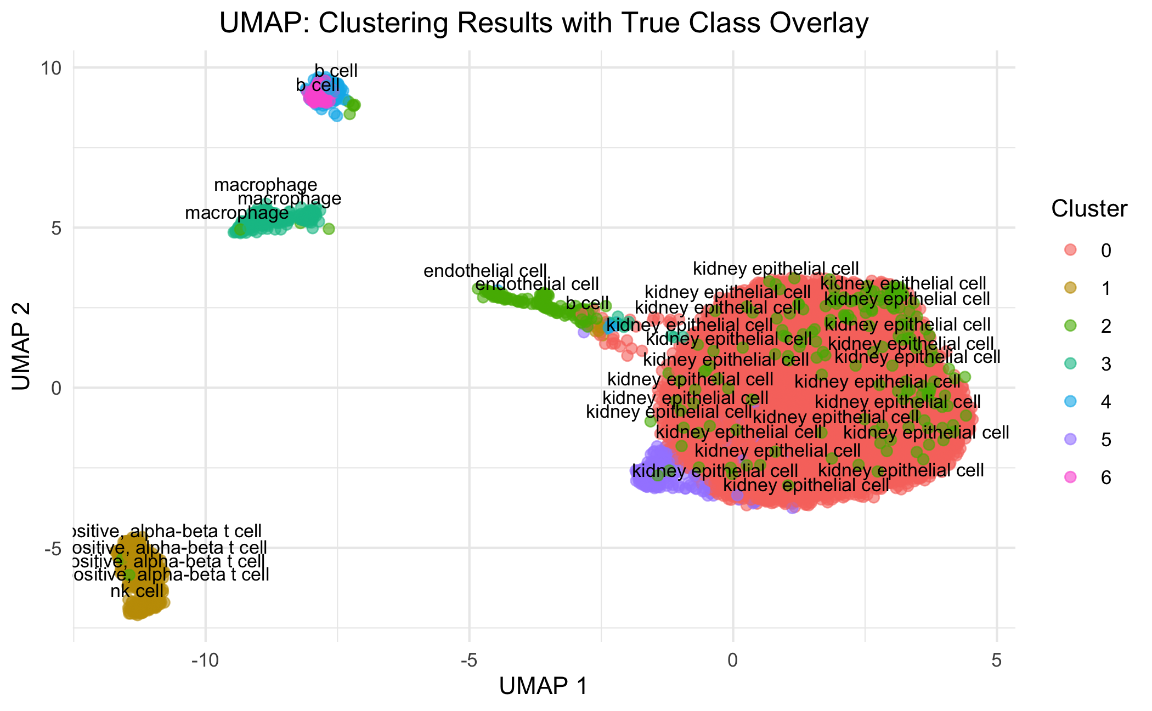
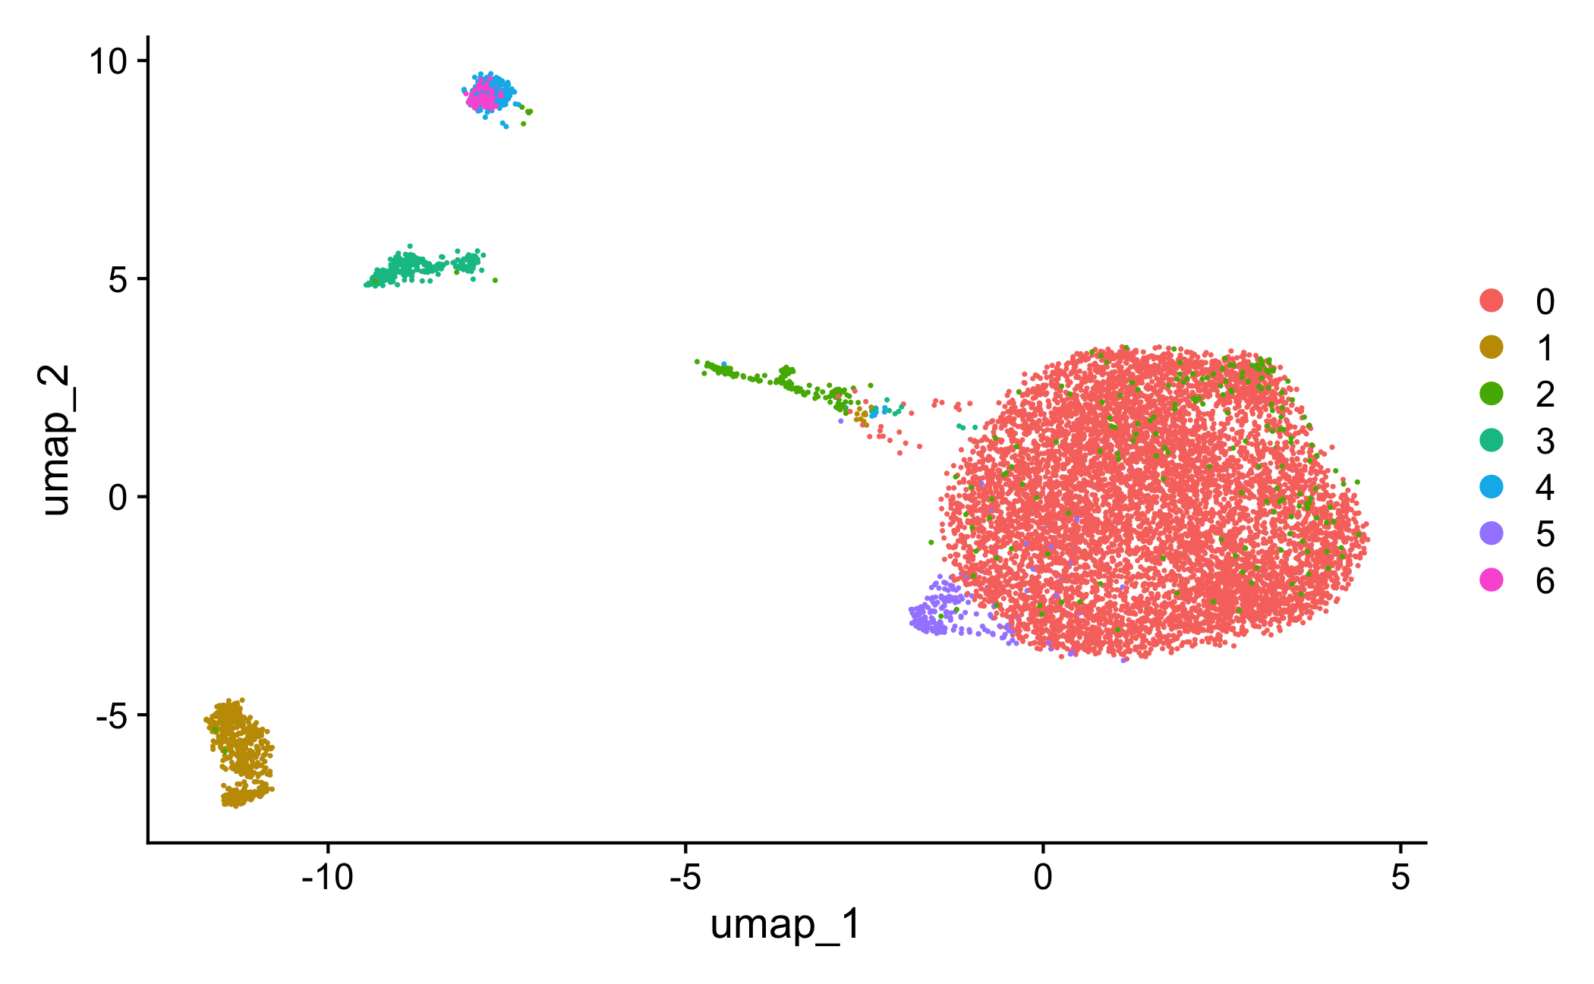
RECOMBINE SSH-SSL
ARI: 0.818
-Could clearly recognize kidney epithelial cells as a single cluster, very similar performance to SCMarker
-Could distinguish NK cells, CD8, CD4 T cells, and B cells even though they are clustered very close

Slide 14
SHC-SSL outperforms both Seurat and SHC
ARI: 0.818
ARI: 0.300
Seurat
SHC-SSL
ARI: 0.222
ARI: 0.892
SCMarker
SHC

Slide 15
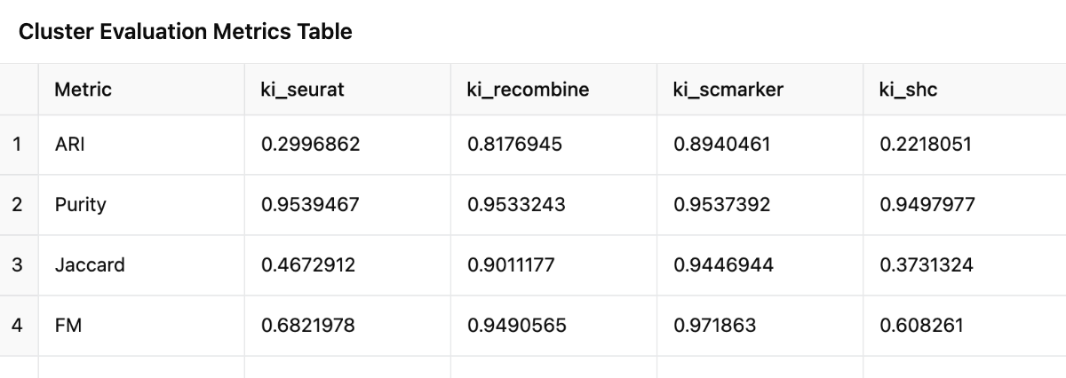
Summary of results

Slide 16
Appendix

Slide 17
Sparse hierarchial clustering
SHC-SSL
SHC-FL

Slide 18
Seurat
SHC
ARI: 0.222
ARI: 0.299
SHC-SSL
SCMarker
ARI: 0.892
ARI: 0.818

Slide 19
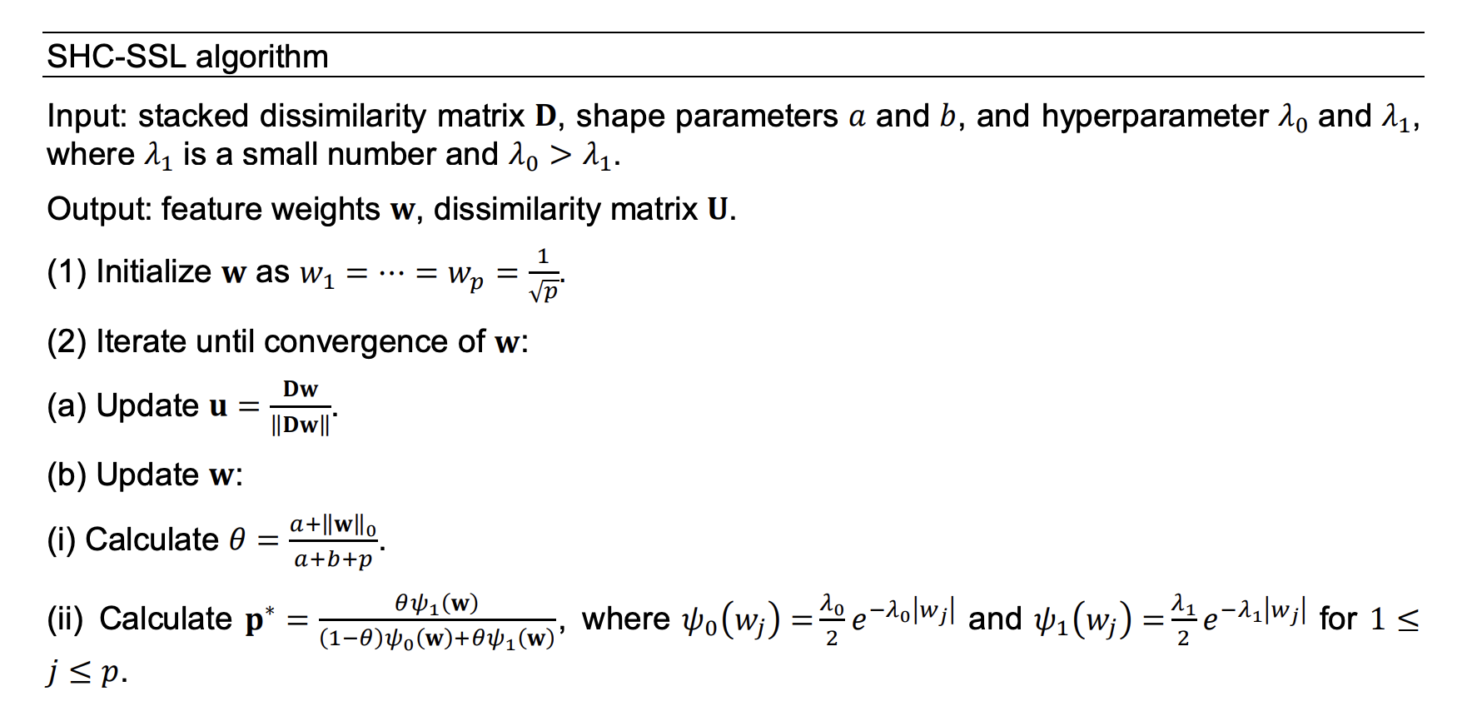
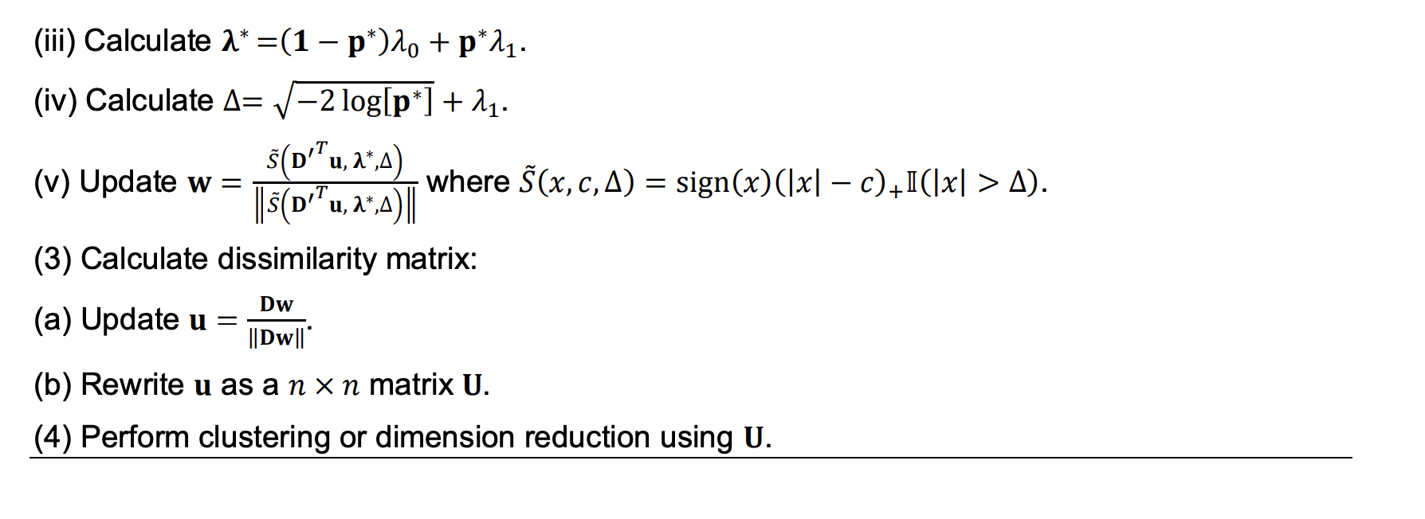

Slide 20
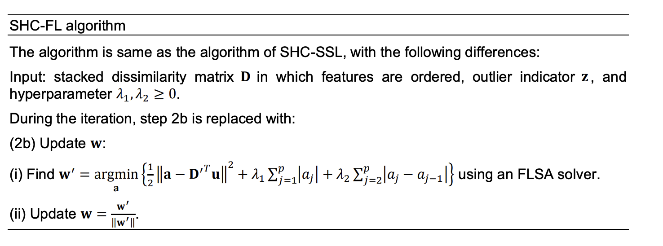

Slide 21
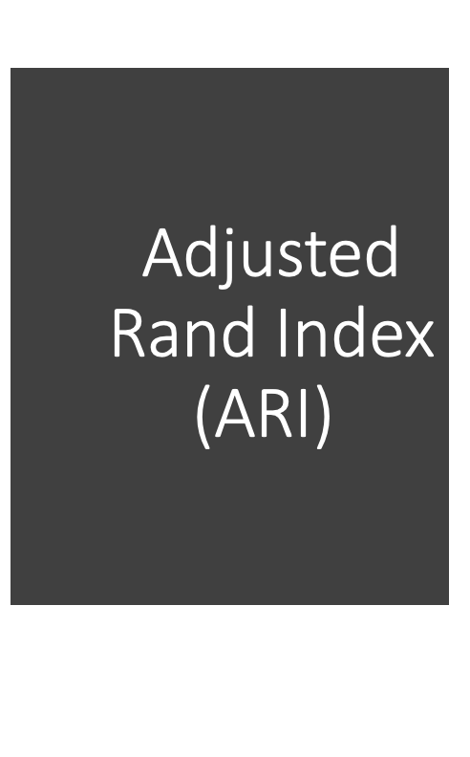
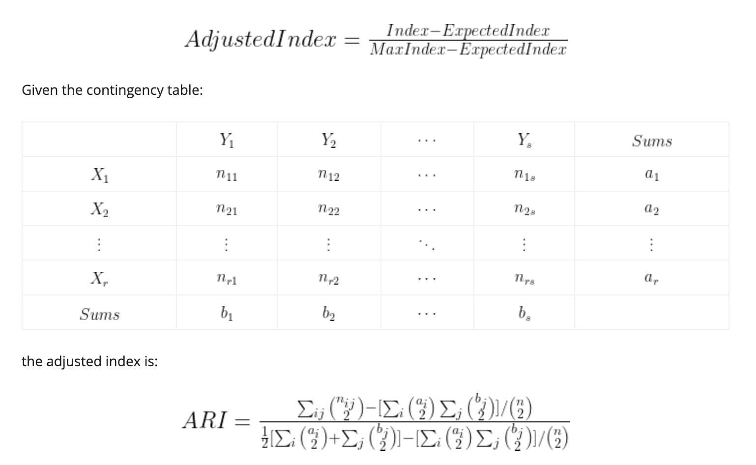
Adjusted Rand Index (ARI)

